Slide 1
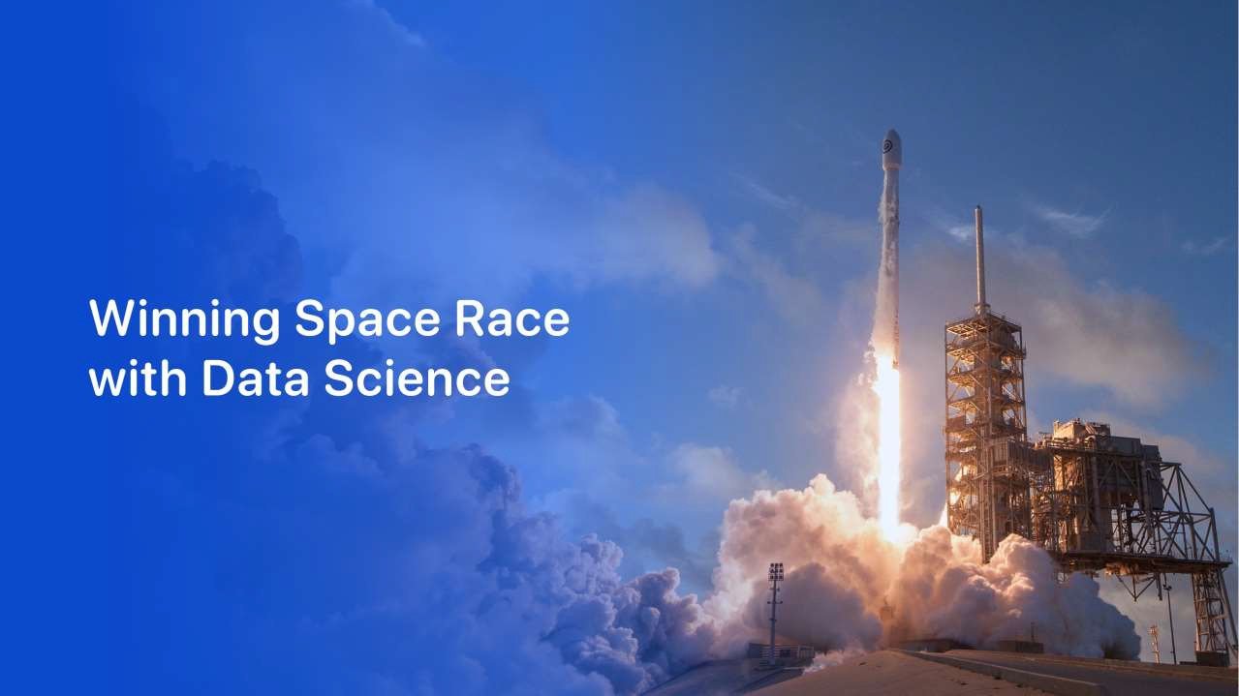

Srikaar Reddy Sheela
15-May-2024

Slide 2
Outline
Executive Summary
Introduction
Methodology
Results
Conclusion
Appendix

Slide 3
Executive Summary
Summary of methodologies
Data Collection and Wrangling
EDA with Visualization and SQL
Folium Map and Plotly Dashboard Construction
Predictive Analysis
Summary of all results
EDA and Interactive Analysis
Predictive Analysis

Slide 4
Introduction
Project background and context
SpaceX is the most successful company of the commercial space age, making space travel affordable. The company advertises Falcon 9 rocket launches on its website, with a cost of 62 million dollars; other providers cost upward of 165 million dollars each, much of the savings is because SpaceX can reuse the first stage. Therefore, if we can determine if the first stage will land, we can determine the cost of a launch. Based on public information and machine learning models, we are going to predict if SpaceX will reuse the first stage.
Problems you want to find answers
Dependency of success of landings on various factors
Trend in success rate over the years
Most suitable algorithm for prediction
4

Slide 5

Section 1
5

Slide 6
Methodology
Executive Summary
Data collection methodology:
SpaceX REST API and Web Scraping
Perform data wrangling
Filter, Impute and Encode the data for classification
Perform exploratory data analysis (EDA) using visualization and SQL
Perform interactive visual analytics using Folium and Plotly Dash
Perform predictive analysis using classification models
Initialize the model object, train, test and validate to properly tune the
hyperparameters for optimal results
6

Slide 7
Data Collection
Describe how data sets were collected.
Involves data collection from both the api and web scraping to complete the
dataset
Schema obtained by API
FlightNumber, Date, BoosterVersion, PayloadMass, Orbit, LaunchSite, Outcome, Flights,
GridFins, Reused, Legs, LandingPad, Block, ReusedCount, Serial, Longitude, Latitude
Schema obtained by web scraping
Flight No., Launch site, Payload, PayloadMass, Orbit, Customer, Launch outcome, Version Booster, Booster landing, Date, Time

Slide 8
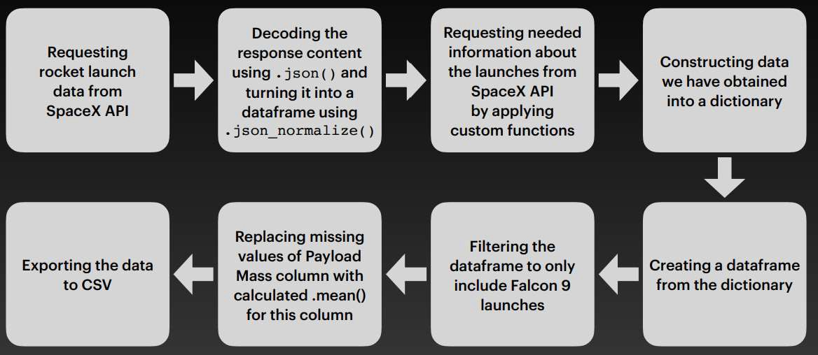
Data Collection – SpaceX API
GH WEB API

Slide 9
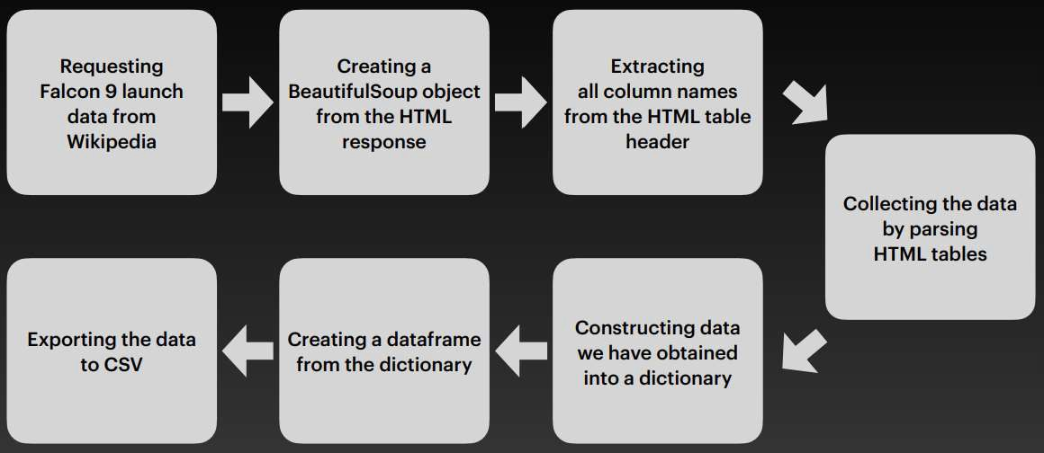
Data Collection - Scraping
GH WEBSCRAPE

Slide 10
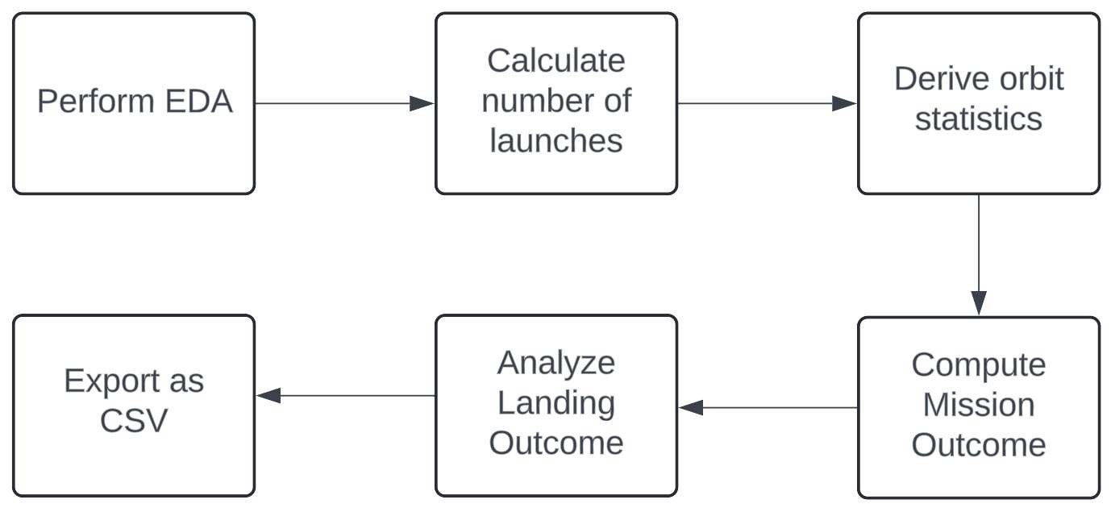
Data Wrangling
GH DATA WRANGLING

Slide 11
EDA with Data Visualization
Scatter plots show the relationship between variables. If a relationship exists, they could be used in machine learning model.
Bar charts show comparisons among discrete categories. The goal is to show the relationship between the specific categories being compared and a measured value. Line charts show trends in data over time
Charts were plotted:
Flight Number vs. Payload Mass, Flight Number vs. Launch Site, Payload Mass vs. Launch Site, Orbit Type vs. Success Rate, Flight Number vs. Orbit Type, Payload Mass vs Orbit Type and Success Rate Yearly Trend
GH EDA VISUAL

Slide 12
EDA with SQL
Performed SQL queries:
Displaying the names of the unique launch sites in the space mission
Displaying 5 records where launch sites begin with the string ‘CCA’
Displaying the total payload mass carried by boosters launched by NASA (CRS)
Displaying average payload mass carried by booster version F9 v1.1
Listing the date when the first successful landing outcome in ground pad was achieved
Listing the names of the boosters which have success in drone ship and have payload mass greater than 4000 but less than 6000
Listing the total number of successful and failure mission outcomes
Listing the names of the booster versions which have carried the maximum payload mass
Listing the failed landing outcomes in drone ship, their booster versions and launch site names for the months
in year 2015
Ranking the count of landing outcomes (such as Failure (drone ship) or Success (ground pad)) between the
date 2010-06-04 and 2017-03-20 in descending order
GH EDA SQL

Slide 13
Build an Interactive Map with Folium
Added Marker with Circle, Popup Label and Text Label of NASA Johnson Space Center and all the launch centers using its latitude and longitude coordinates as a start location
Added coloured Markers of success (Green) and failed (Red) launches using Marker Cluster to identify which launch sites have relatively high success rates.
Added coloured Lines to show distances between the Launch Site KSC LC-39A (as an example) and its proximities like Railway, Highway, Coastline and Closest City
GH FOLIUM

Slide 14
Build a Dashboard with Plotly Dash
Pie Chart showing Successful Launches
Launch Sites Dropdown List
Slider of Payload Mass Range
Scatter Chart of Payload Mass vs. Success Rate for the different Booster Versions
GH DASHBOARD
14

Slide 15
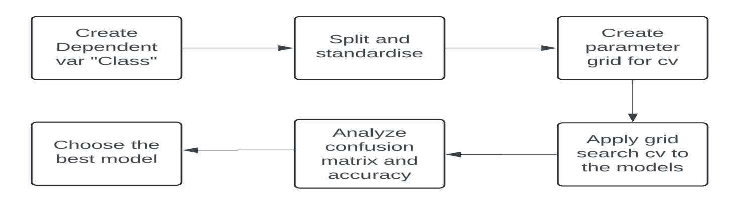
Predictive Analysis (Classification)
GH ML PREDICTION

Slide 16
Results
Exploratory data analysis results
Interactive analytics demo in screenshots
Predictive analysis results

Slide 17

Section 2

Slide 18
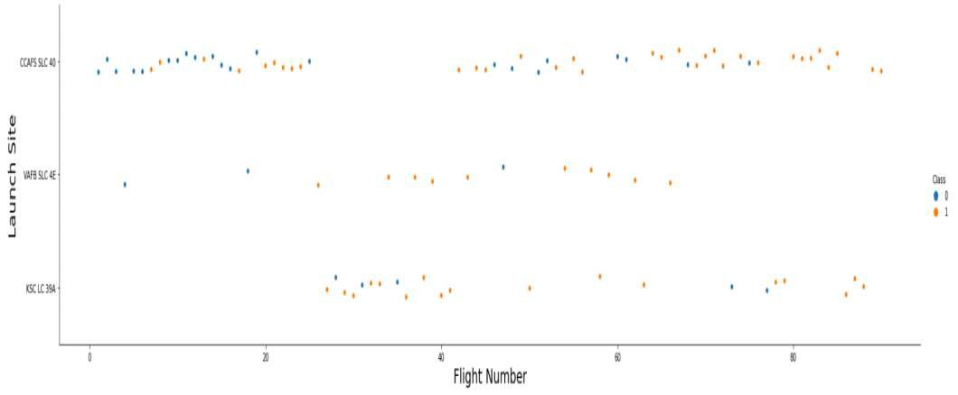
Flight Number vs. Launch Site
Scatter plot of flights are shown here, earlier flights have a low success rate which
implies that success rate improves with time.

Slide 19
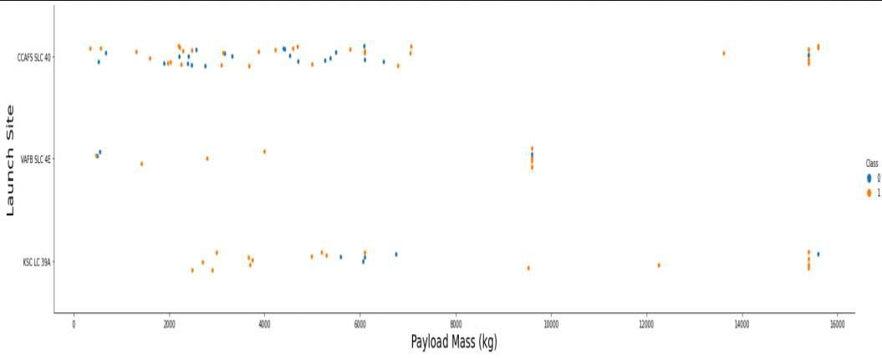
Payload vs. Launch Site
Generally, higher the payload, greater the chances of success. However, KSC LC
39A
Has a high success rate.

Slide 20
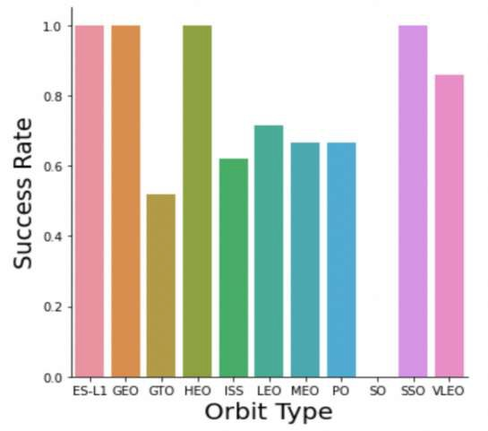
Success Rate vs. Orbit Type
SO has 0% success rate
ES-L1, GEO, HEO, SSO
have a 100% success rate

Slide 21
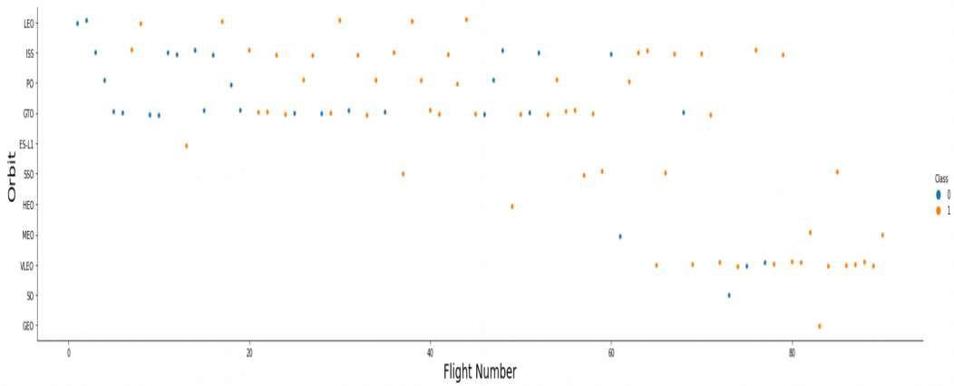
Flight Number vs. Orbit Type
Its difficult to fix a relationship when the orbit is GTO. In LEO the success rate
seems to be increasing with flight number.

Slide 22
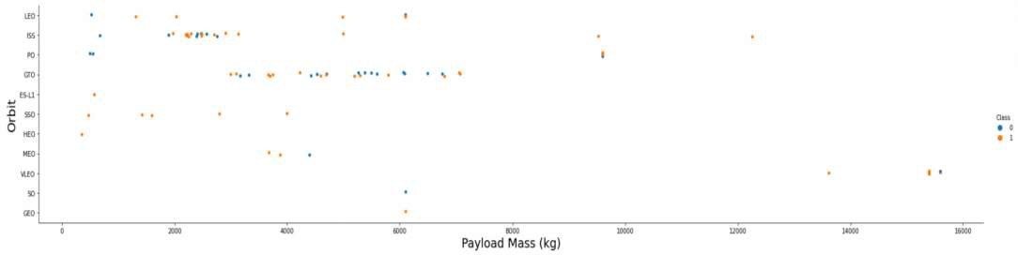
Payload vs. Orbit Type
Generally heavy payloads imply a higher success rate in Polar LEO, however that
changes in GTO.

Slide 23
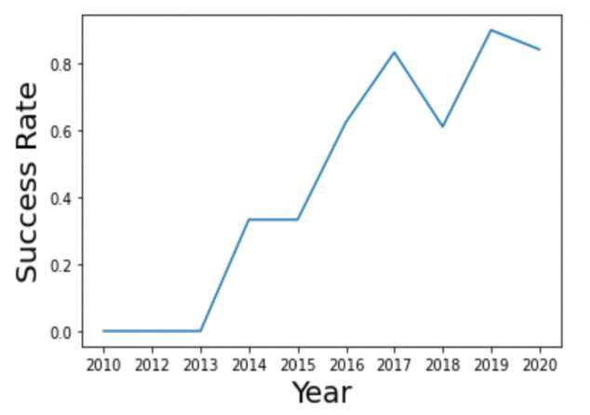
Launch Success Yearly Trend
Success rate is generally increasing year-on-year rapidly from 2013-2017
A sharp drop occurs on 2018 and a slight drop again on 2020

Slide 24
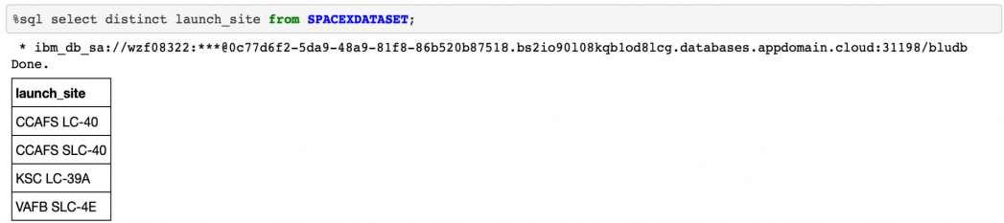
All Launch Site Names
Display unique names of launch sites using the distinct keyword in query. A
total of 4 launch sites exist.

Slide 25
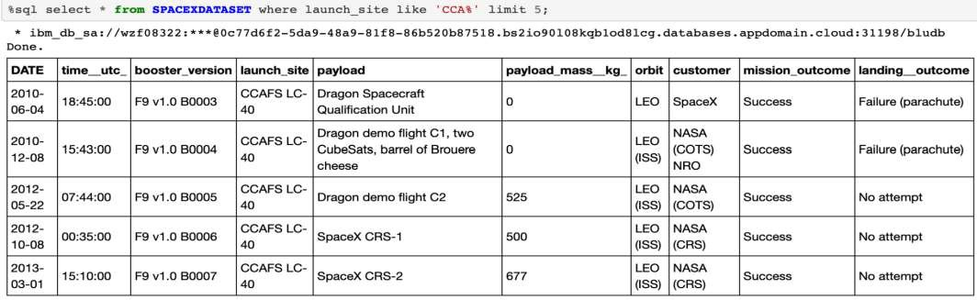
Launch Site Names Begin with 'CCA'
Finding 5 records where launch sites begin with `CCA`

Slide 26
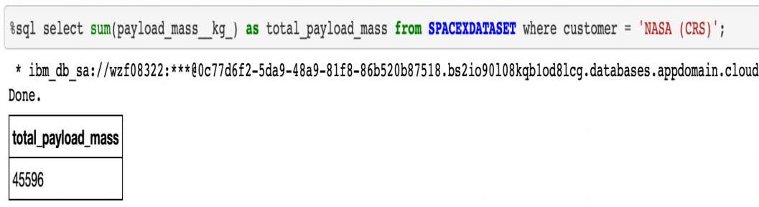
Total Payload Mass
Calculated the total payload carried by boosters from NASA

Slide 27
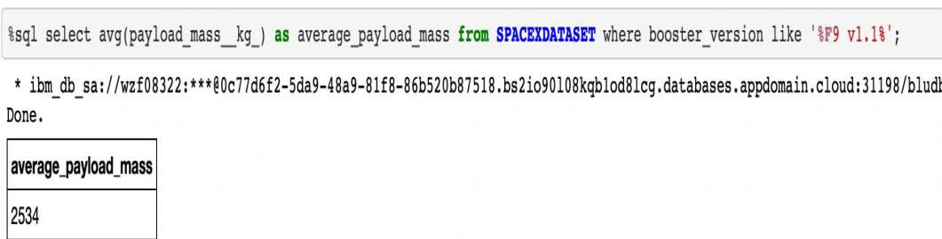
Average Payload Mass by F9 v1.1
Calculated the average payload mass carried by booster version F9 v1.1

Slide 28
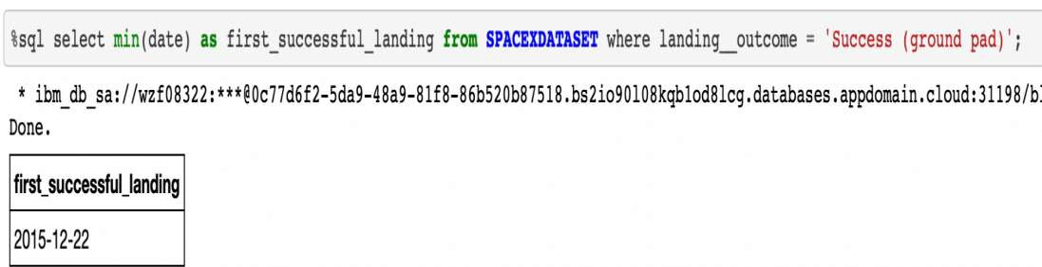
First Successful Ground Landing Date
Found the dates of the first successful landing outcome on ground pad

Slide 29
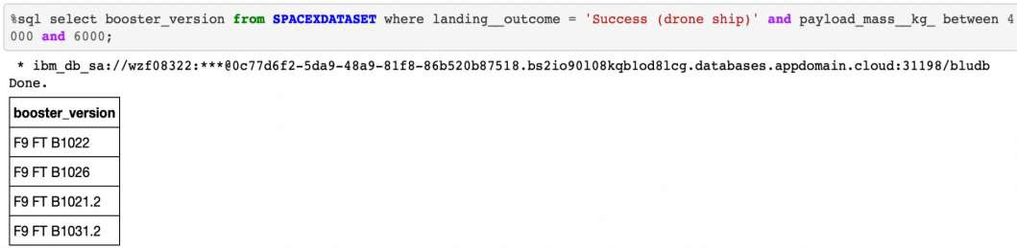
Successful Drone Ship Landing with Payload between 4000 and 6000
Lists the names of boosters which have successfully landed on drone ship
and had payload mass greater than 4000 but less than 6000

Slide 30
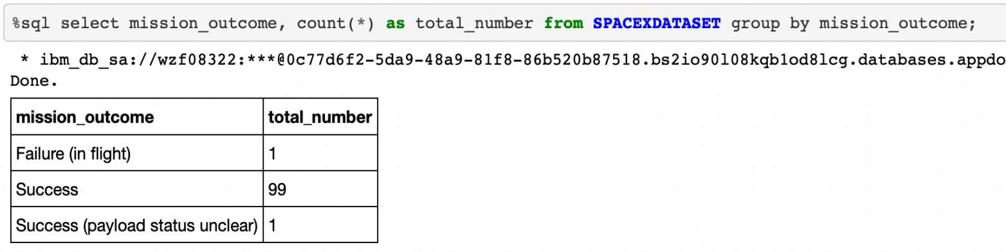
Total Number of Successful and Failure Mission Outcomes
Calculated the total number of successful and failure mission outcomes

Slide 31
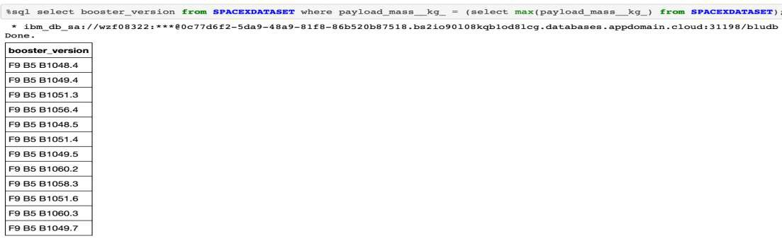
Boosters Carried Maximum Payload
Lists the names of the booster which have carried the maximum payload
mass

Slide 32
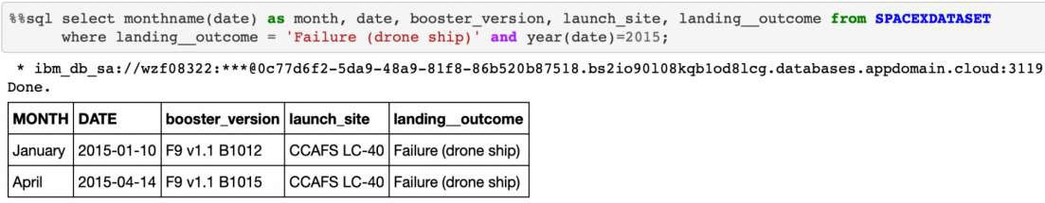
2015 Launch Records
Lists the failed landing outcomes in drone ship, their booster versions,
and launch site names for in year 2015

Slide 33
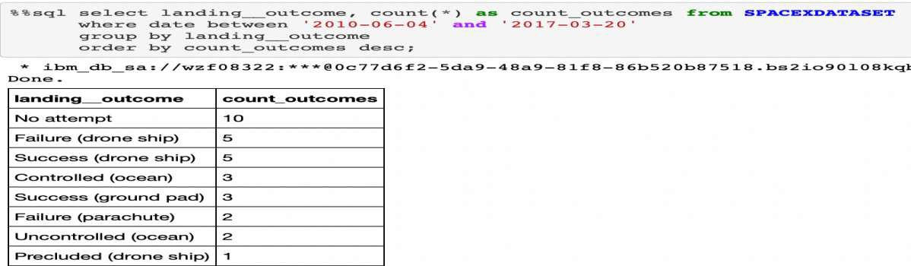
Rank Landing Outcomes Between 2010-06-04 and 2017-03-20
Ranking the count of landing outcomes (such as Failure (drone ship) or Success (ground pad)) between the date 2010-06-04 and 2017-03-20, in descending order

Slide 34

Section 3

Slide 35
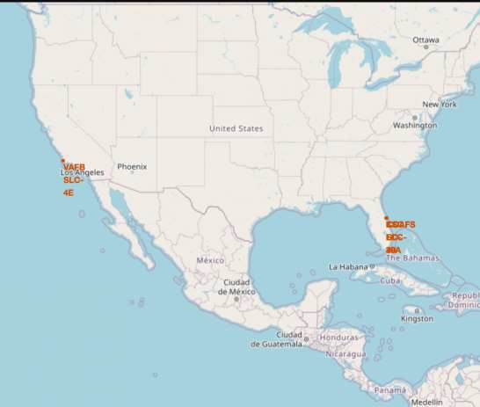
Launch Sites
Most of Launch sites are in proximity to the Equator line and the coast to minimise risks of crashes. The land is moving faster at the equator than any other place on the surface of the Earth. Anything on the surface of the Earth at the equator is already moving at 1670 km/hour. If a ship is launched from the equator it goes up into space, and it is also moving around the Earth at the same speed it was moving before launching. This is because of inertia. This speed will help the spacecraft keep up a good enough speed to stay in orbit.

Slide 36
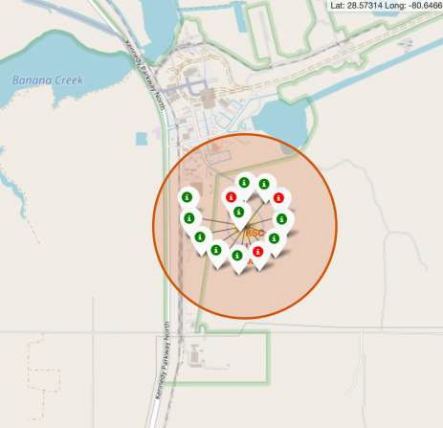
Launch Records
From the colour-labelled markers we should be able to easily identify which launch sites have relatively high success rates. –
Green Marker = Successful Launch Red Marker = Failed Launch

Slide 37
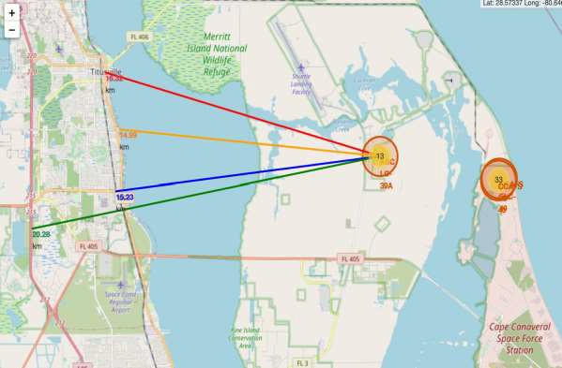
Proximity of the Launch Site
From the visual analysis of the launch site KSC LC-39A we can clearly see that it is:
relatively close to railway (15.23 km)
relatively close to
highway (20.28 km)
relatively close to
coastline (14.99 km)

Slide 38

Section 4

Slide 39
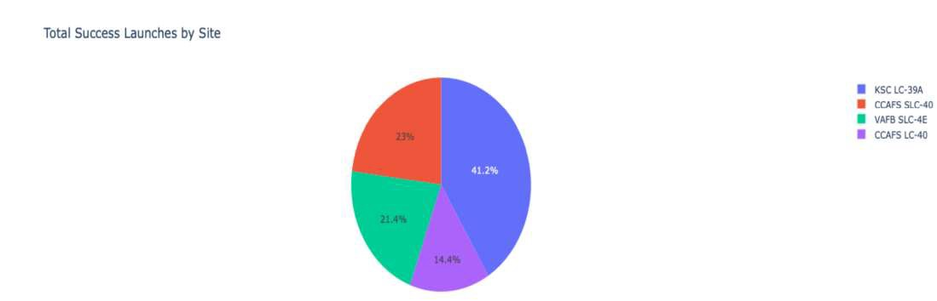
Success Share
KSC LC-39A has the highest share of successful landings
Whereas CCAFS LC-40 has the lowest

Slide 40
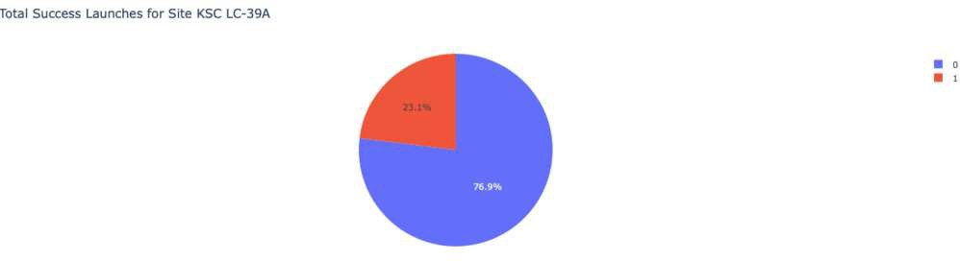
Stats of KSC LC-39A
KSC LC-39A is a reliable launch site with a decent success rate of nearly 77%

Slide 41
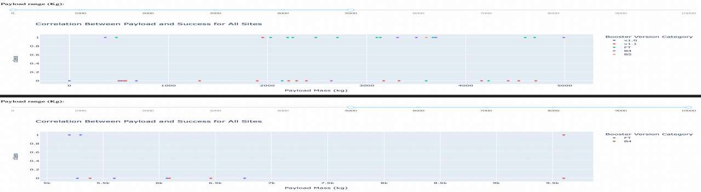
Payload vs Outcome
We can see the relation between Payload Mass vs Launch Outcome for all sites. Most successes are in the range 2000kg-5000kg

Slide 42

Section 5

Slide 43
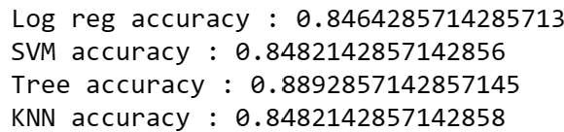
Classification Accuracy
4 ML models – Logistic Regression, Support Vector Machine, Decision Tree and K-nearest Neighbours are built and validated
The best accuracy is chosen from
the grid search cv.

Slide 44
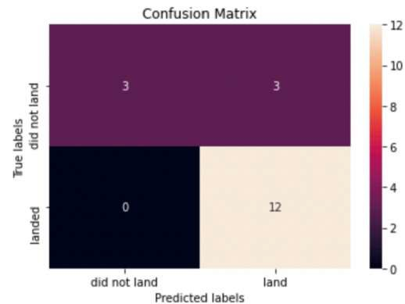
Confusion Matrix
A relatively high False Positive Rate is evident in the model

Slide 45
Conclusions
Decision Tree has the best performance
Launches with payloads in a specific range of payload(2000-5000kg) have a higher success rate
As time goes by, the success rate of launches and landings is increasing
KSC LC-39A is the most reliable launch site
In the orbits ES-L1, GEO, HEO and SSO the success rate is a perfect 100%

Slide 46
Appendix
Resources used are majorly provided by: https://www.ibm.com/ https://www.coursera.org/
Applied Data Science Capstone - Introduction - Week 1 | Coursera
SpaceX

Slide 47
